Slide 1
Why Not Python?
I am Bhavani Ravi
♥️ Python & 💪 #WomenInTech
Twitter @geeky_bhavani

Slide 2
What Do I Do?
Software Engineer - Orangescape
Organizer - Build2Learn
Lead - WomenTechMakers Chennai
Blogger
Paying Forward
Mentoring, Supporting, Motivating

Slide 3
Why Python?

Slide 4
Where Does the ♥️ Begins?

Slide 5
The Simplicity
>>> print (“Hello World”)
And it all started right here...

Slide 6
The Simplicity
>>> 5 + 2

Slide 7
The Simplicity
>>> “Split me”.split()
[“Split”, “me”]

Slide 8
There should be one and
preferably only one
obvious way to do it.
The Zen Of Python
Notes:
Beautiful is better than ugly. Explicit is better than implicit. Simple is better than complex. Complex is better than complicated. Flat is better than nested. Sparse is better than dense. Readability counts. Special cases aren't special enough to break the rules. Although practicality beats purity. Errors should never pass silently. Unless explicitly silenced. In the face of ambiguity, refuse the temptation to guess. There should be one-- and preferably only one --obvious way to do it. Although that way may not be obvious at first unless you're Dutch. Now is better than never. Although never is often better than *right* now. If the implementation is hard to explain, it's a bad idea. If the implementation is easy to explain, it may be a good idea. Namespaces are one honking great idea -- let's do more of thosee

Slide 9
Python Is Everywhere

Slide 10
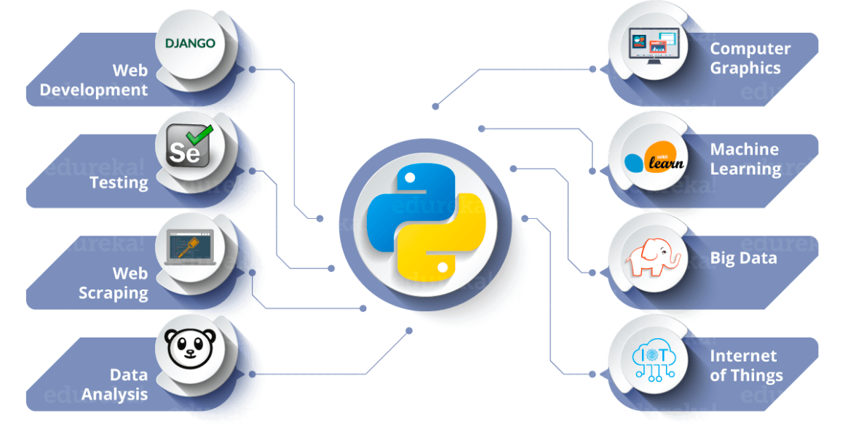

Slide 11
Python Pays Well.

Slide 12
₹ 10,00,000
Whoa! That’s a big number.

Slide 13
Python Supports

Slide 14
12,18,060
Questions In StackOverflow

Slide 15
500+
80+
28
User Groups
PyLadies Communities
Conferences

Slide 16
Did I sell Python Well?

Slide 17
Where Do I Start?

Slide 18
Always Start with the Documentation
https://www.python.org/about/gettingstarted/

Slide 19
Why?
Good Code Comes With Good Documentation.
“Getting started” are the doors for you to enter.
It gives you a sense of completeness.

Slide 20
It is a Journey
Master Learn the Basics
Practice by building
Inspire Others

Slide 21
Look Out !!
Syntax
Logic
Algorithms

Slide 22
Use an IDE
Let those people judge you

Slide 23
Reach
Out For Help

Slide 24
500+
80+
28
User Groups
PyLadies Communities
Conferences

Slide 25

Let’s get into some action?

Slide 26
More Resources
https://realpython.com/python-beginner-tips/
https://learnxinyminutes.com/docs/python3/
https://github.com/vinta/awesome-python
https://www.reddit.com/r/beginnerprojects/

Slide 27
My Python Story
Was a Java Developer (Don’t Judge me)
Learned Python - 4 hours
My First Python Project - 5 days
Now. Java? Never.

Slide 28
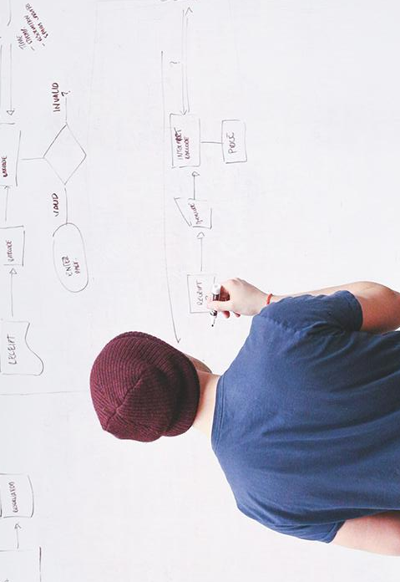
THANKS!
Any questions?
You can find me at:
@geeky_bhavani

